Slide 1
Interactive SSI Wallet
Transparent, DIDComm-based Self-Sovereign Identity
Julian Böhm · Maximilian Kolb · Adrian Brag · Arian Kabiri · Lennard Becker

Slide 2
Agenda
Problem & Solution Approach
System Architecture & Design
Tech Stack & Tools
Work Distribution & Collaboration
MVP Demo
Next Steps & Roadmap
2026 | Internet of Services Lab | Page 2
Notes:
Our agenda for the presentation is as follows, first, I will tell you something about the Problem we are targeting and afterwards my collegues will tell you something about the System Architecture, the Tech Stack and Tools we are using and the Work Distribution. Afterwards Adrian will show you a small demo of our current state.

Slide 3
Problem & Solution Approach
The Problem
Our Solution
→ Identity data is siloed and controlled by centralized providers
→ Users have no insight into who verifies their credentials
→ Revocations and DID changes are opaque to wallet holders
→ No transparent log of interactions
✓ SSI-based mobile wallet giving users full identity control
✓ DIDComm for secure, standards-based messaging
✓ Push notifications via mediator for real-time credential events
✓ Transparency log exposing DID operations to the holder
2026 | Internet of Services Lab | Page 3
Notes:
So, the general topic is the current state of digital identity. Today, our identity data is siloed—it is trapped inside centralized databases controlled by massive providers, like tech giants or government registries.
Which means, users have no insight into who actually verifies our credentials.
Secondly the „source of truth“ is opaque. If our credential is revoked, your wallet stays silent until a transaction fails.
And finally there is no log of what your wallet did in your behalf and what data it used.
"Let me give you a quick example of what I mean. Imagine Alice is applying for a job and shares her digital diploma from her wallet.
Right now, it’s a total 'black box.' She hits 'Share,' a spinner runs for a few seconds, and then it’s just gone. She has no idea what actually happened. Did the employer just verify she graduated? Did they dig into her exact grades? Did they check if the credential was even valid?
She’s basically forced to just click 'approve' and hope for the best. She has no visibility, and more importantly, she has no proof of what her own wallet actually did behind the scenes."
"So, how do we move from this 'black box' to a system Alice can actually trust? Our project proposes a transparent, SSI-based mobile wallet that puts the user back in control through four core pillars:
· First, Self-Sovereignty: Your identity data lives with you, not in a central database you don't control.
· Second, Secure Standards: We use DIDComm for all communications. This ensures every interaction is encrypted and mutually authenticated, so you aren't locked into a single vendor.
· Third, Real-Time Updates: Through a mediator service, we’ve added a 'Push' channel. Your wallet no longer sits idle; it alerts you to credential changes—like revocations—the moment they occur, rather than leaving you in the dark until a transaction fails.
· Finally, the Transparency Log: This is the heart of our project. Every action your wallet performs is recorded in a tamper-evident, human-readable log.

Slide 4
System Architecture
Overview
Issuer
(University / Bank)
DIDComm
Wallet
(Flutter App)
Mediator
(Credo-ts)
DIDComm
Wallet Agent
(Credo-ts)
Verifier
(Customer)
DIDComm
Push
VON
(Ledger)
Ledger events
Each mobile wallet registers at the mediator, which queues incoming
DIDComm messages and triggers push notifications to wake the app.
2026 | Internet of Services Lab | Page 4

Slide 5
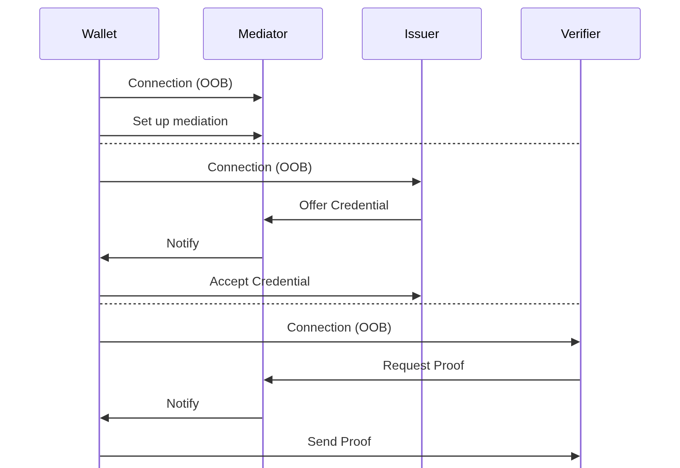
System Architecture
Communication
2026 | Internet of Services Lab | Page 5

Slide 6
Tech Stack & Tools
Credo-ts
Flutter
TypeScript SSI framework.
Runs the wallet agent and mediator.
Offers DIDComm compatibility
Cross-platform mobile framework for the wallet UI. Communicates with Credo-ts via HTTP/WebSocket.
GitHub Projects, Discord
VON Network
Task tracking and sprint management via GitHub Issues and Milestones.
Communication via messages and calls in Discord
Hyperledger Indy-based VDR for DID registration and credential schema anchoring in the local test network.
2026 | Internet of Services Lab | Page 6
Notes:
The technology stack we are using is as follows:
For the wallet agent and the mediator, we are using a framework called Credo-TS. This framework runs on TypeScript and offers DIDComm compatibility.
For the wallet UI, we are using the Flutter framework. Our current Linux app is built using Flutter and communicates with the Credo-TS agent via HTTP and WebSockets. Our plan is to integrate the Credo-TS framework with Node.js within Flutter, ensuring that every wallet instance runs its own local server.
For task tracking and sprint management, we use GitHub Issues and Milestones, while our daily communication takes place on Discord.
Finally, for testing, we are using the VON network—a ledger environment provided by the Government of British Columbia—which we deploy locally using Docker to run the actual Indy ledger infrastructure on our machines.

Slide 7
Work Distribution & Collaboration
How We Collaborate
Task Split by Track
Weekly team sync every Friday at 10:00 AM
Backbone / Infrastructure
Julian, Max · Mediator, Push Notifications, VON
Adrian · Agent setup, OOB connections, HTTP bridge
Supervisor meetings with Sanjeet Raj Pandey
GitHub Issues + Milestones for task tracking
Flutter UI
Arian + Lennard · Credential list, request handling, UI
Organisation: github.com/interactive-wallet
Excalidraw for shared architecture diagrams
2026 | Internet of Services Lab | Page 7

Slide 8
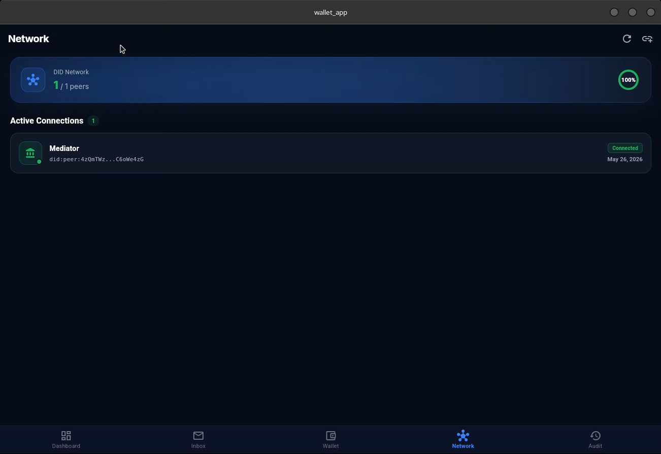
MVP - Current State
Demo
2026 | Internet of Services Lab | Page 8

Slide 9
MVP - Current State
Done / In Demo
In Progress
✓ VON Network running locally (Indy ledger)
→ RabbitMQ as Message Broker
✓ Credo-ts mediator deployed and reachable
→ Push Notification → Wake up App
✓ DIDComm connection flow (OOB invitation→handshake → connection)
→ more detailed transparency log
✓ Credential issuance/verification via credo-ts (issuer/verifier → holder)
→ Integration options for software systems
✓ Flutter app shell with SSE/HTTP connection to credo
2026 | Internet of Services Lab | Page 9
Notes:
einkommende connection requests akzeptieren

